Slide 1
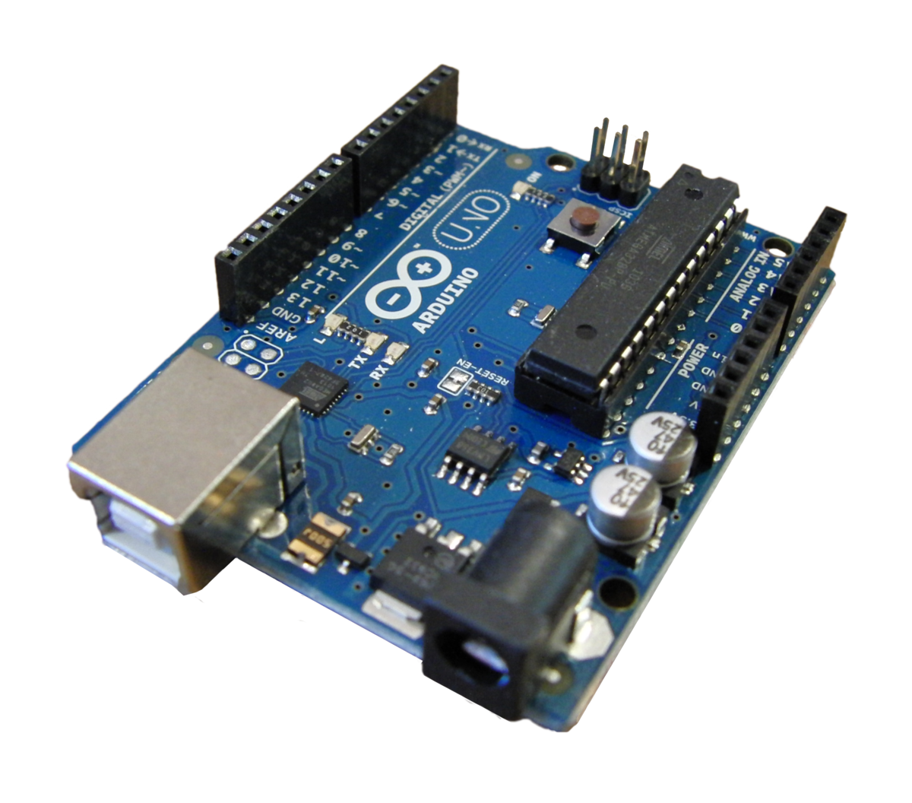
Christian traffic circuit
I started working with circuits a few weeks ago (1st January 2020).
I started with simple circuits and worked my way on with more
Complicated circuits . Now ill present my project that I made but step
By step by using the Arduino.
The Arduino is basically
A circuit maker by Coding
And hardware.

Slide 2
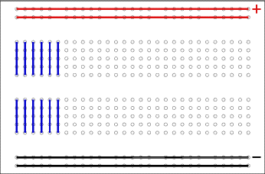
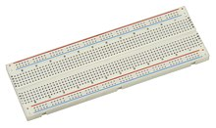
Step 1 :KOWING WHAT YOU WORK WITH
I worked with the Arduino and bread boards also the components.
The bread board is where you can build circuits with rows and holes that allow you to connect together.

Slide 3
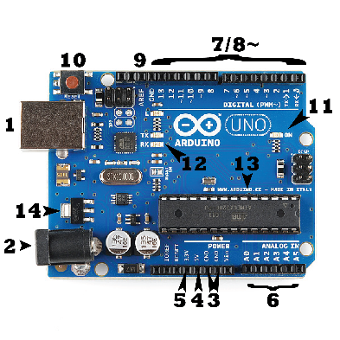
The Arduino
1. The USB port used for powering and sending information from the computer
2. The power connector is used for powering the Arduino when the USB port is not in use with voltage
3. The pin Ground is basically the end of the circuit because it’s the minus closing the circuit to the ground.
4. + 5. is the amount of voltage sending to the voltage. 4. is 5volts and 5. is 3.3volts.
6. The Analog pins send operating voltage(5V or 3.3V) into integer values between 0 and 1023.
7. To 9. are digital pins that can input and output information to the circuit from the microprocessor .
10. Is the reset button that resets the information in the microprocessor.
11. Indicates that your Arduino is receiving power.
12. These LEDs indicates information sending from the computer. Expected to flicker.
13. The Microcontroller is really the heart of the Arduino.
14. Is the 5v voltage regulator making sure the voltage is regulated to 5v voltage.

Slide 4
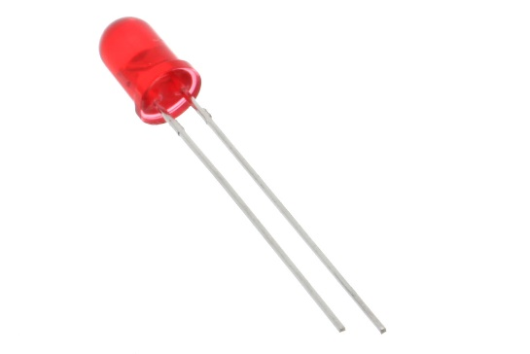
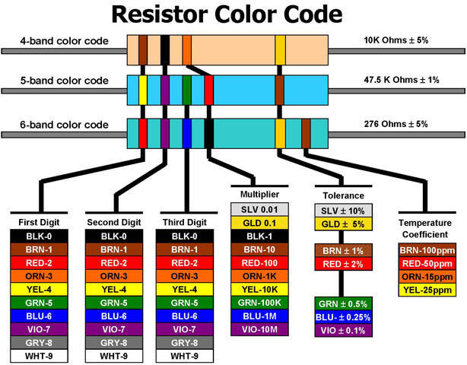
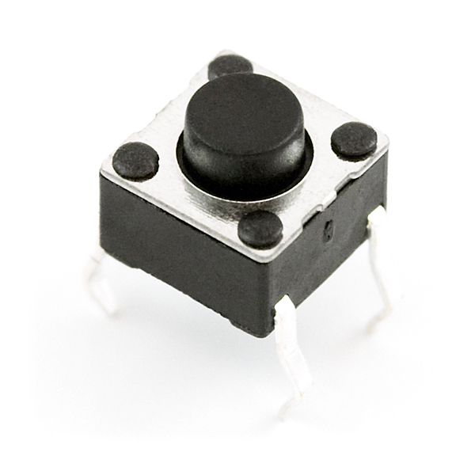
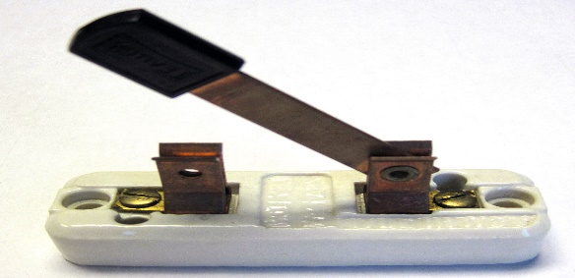
The components
I`ll tell you the components I used for my project
Led is a component that converts electrical energy into light energy.
The shorter leg is Cathode (minus) and the longer leg is Anode(plus).
2. A resistor is a component that resist the flow of voltage in the circuit.
This has many stripes and that is numbered of voltage that it resist.
If the led had too much voltage it would burn out so that’s why you use the resistor.
3. The switch breaks the circuit when off and continue the flow when
It is on . There is all kind of switches example push button and a simple switch.
This the color code it shows how to calculate
The resist of flow voltage.

Slide 5
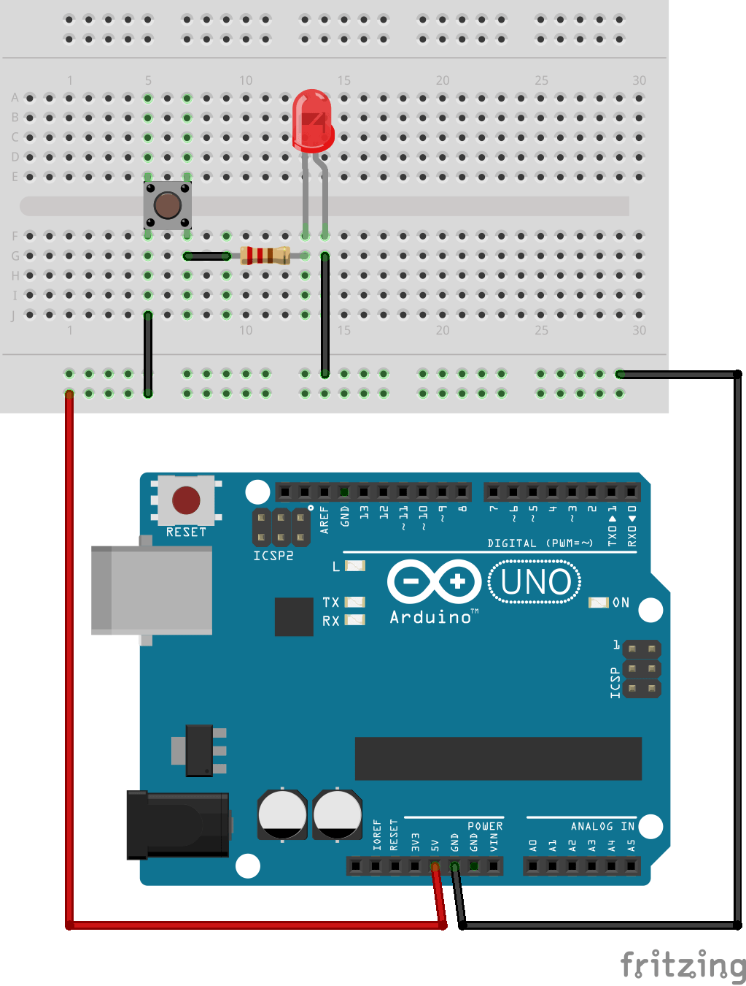
Step 2 : knowing the circuits
When you look at circuits at first they seem complicated but today this will explain a little bit more better.
Circuits always begin with plus and end with minus. The energy flowing through plus to
minus is called voltage . My voltage (V) is coming from the computer which is connected
To the Arduino by USB cable also the minus ends in the ground from the Arduino. Current (I) is the amount of voltage going through a wire and resistance(ohm) is the amount of resisted current. When lighting a LED it is really important to know how much resistance it needs or else it will burn out . There is a formula for that method I = V/R,
= 5v/220ohm = 0.023 A = 23 mA (Ohm low) this how to get the current of the voltage.
Now you know
The current you can get started by lighting a LED
By an Arduino.

Slide 6
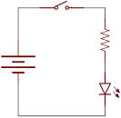
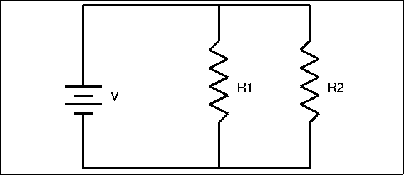
More information about circuits
button
As we saw on the fist circuit you can put multipole LEDs if it’s the right resistance and current. Now we are going to add switches. Example
In coding the switch is like the input and the LED is an output. Now it is really
Important to understand schematics for example this one
resistor
Power source
resistor
There are two types of circuits serial and parallel . Serial circuits has only one route for
Example if one component is not working the route does not work. Parallel circuits has many
routes altogether for example your kitchen is a parallel circuit because if one thing does not
Work other components still work. This circuit on the top is serial and the bottom is parallel . So if the first resistor does not work the other works because that circuit has more than one route to the power source.
LED
resistor
Power source

Slide 7
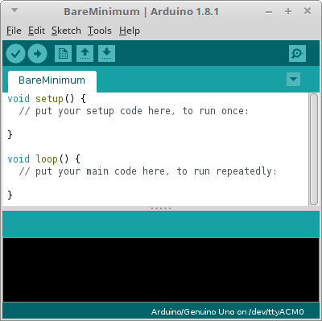
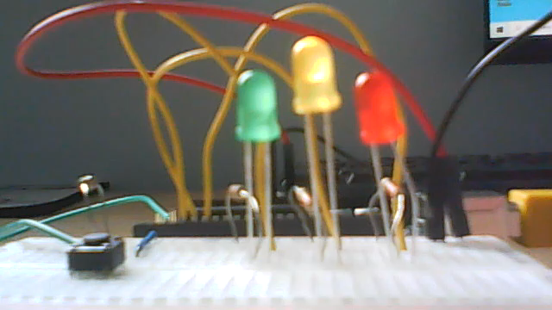
Programing with the Arduino
This here is the code for the basic traffic lights
You have to make a variable that makes
The switch state which is equals to zero.
int switch State = 0;
void setup()
{
pin Mode(2, INPUT);
pin Mode(3, OUTPUT);
pin Mode(4, OUTPUT);
pin Mode(5, OUTPUT);
}
void loop()
{
switch State = digital Read(2);
if (switch State == LOW) {
digital Write(3, LOW);
digital Write(4, HIGH);
digital Write(3, LOW);
delay(250);
digital Write(4, LOW);
delay(250);
}
else {
digital Write(3, LOW);
digital Write(4, LOW);
digital Write(5, HIGH);
delay(2000);
digital Write(4, HIGH);
digital Write(5, LOW);
delay(250);
delay(2250);
digital Write(4, LOW);
digital Write(3, HIGH);
delay(2250);
}
}
All the code sent from the computer is
Received by the microprocessor and it
Runs the code for the circuit. You always have to set up the pins on the Arduinos
Like putting the pins that are output and input.
If your variable wants to be turned on you
Put the pin that will receive voltage. In this
Programming high is on and low is off also to
Make it wait you put on delay 1000 is one
Second.
There are two main functions that you always put , void setup and void loop
Void setup is only doing it ounce like setting the pins and void loop is going to run the code over again and again just like an LED.
This is the code run on the circuit.

Slide 8
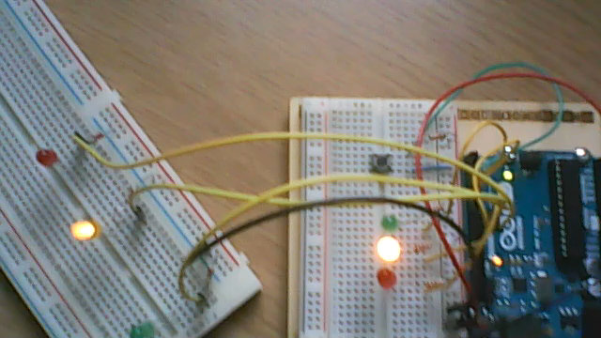
The project
It was not really hard to make this final project because I already made the first one and now this one is just adding 3 more LEDs.
int switch State = 0;
void setup()
{
pin Mode(2, INPUT);
pin Mode(3, OUTPUT);
pin Mode(4, OUTPUT);
pin Mode(5, OUTPUT);
pin Mode(8, OUTPUT);
pin Mode(9, OUTPUT);
pin Mode(10, OUTPUT);
}
void loop()
{
switch State = digital Read(2);
if (switch State == LOW) {
digital Write(3, LOW);
digital Write(4, HIGH);
digital Write(3, LOW);
digital Write(8, LOW);
digital Write(9, HIGH);
digital Write(10, LOW);
delay(250);
digital Write(4, LOW);
digital Write(9, LOW);
delay(250);
}
else {
digital Write(3, LOW);
digital Write(4, LOW);
digital Write(5, HIGH);
digital Write(8, HIGH);
digital Write(9, LOW);
digital Write(10, LOW);
Here is the code
delay(5000);
digital Write(5, HIGH);
digital Write(9, HIGH);
digital Write(8, LOW);
delay(1250);
delay(2250);
digital Write(4, LOW);
digital Write(3, HIGH);
digital Write(10, HIGH);
digital Write(9, LOW);
digital Write(5, LOW);
delay(3250);
delay(2250);
digital Write(4, HIGH);
digital Write(3, LOW);
digital Write(10, HIGH);
digital Write(9, LOW);
digital Write(5, LOW);
delay(2250);
digital Write(4, LOW);
digital Write(10, LOW);
digital Write(5, HIGH);
digital Write(9, HIGH);
delay(2250);
}
}
Here is the final point of the project/video
Thank you for listening to my presentation
To my project. I hoped you enjoyed it.

